Slide 1
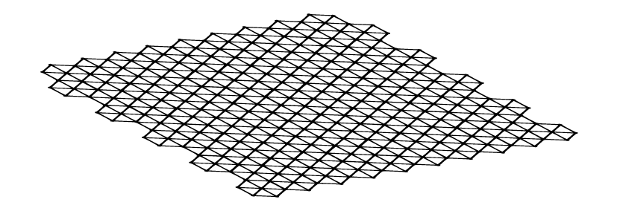
Non-Stabilized Section
TriAx Geogrid
PROJECT
Name
LOCATION
City, ST
OWNERS
Name
CONTRACTOR
Name
ENGINEER
Name
INSTALLATION DATE
Month Year
PROJECT DETAILS
Brief text describing project
PERFORMANCE IMPROVEMENT
Approx??
TX5 Geogrid
DRUMP TRUCKS REDUCTION
2,900 Trucks
PRODUCT
TriAx® Geogrid Non-Standard Special Provision (NSSP) Types 3
250,000 square yards
MATERIALS SAVINGS
## of Imported XXXXX material
## of Exported XXXXX material
TIME SAVINGS
Approx??
COST SAVINGS
Approx??
TriAx_PP_State_ProjectName_MM.YY

