Slide 1
Phase 2 Geosynthetics Study
WTI/Montana State
Study Report Discussion and Tensar Response

Slide 2
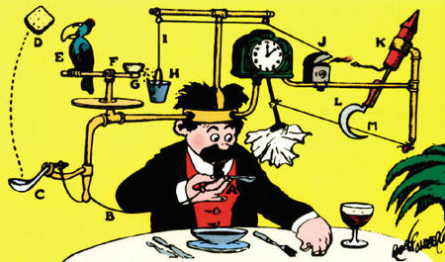
Happy 131st Birthday, Rube Goldberg
Self-Activating Napkin
Pulitzer Prize-winning cartoonist, who devised machines to make simple tasks outrageously difficult

Slide 3
Agenda
Background on Montana Research
Phase 2 Study Design and Execution
Study Results
Tensar Response

Slide 4
Background
Phase 1 study was conducted from February 2008 to July 2009 and was funded by Naue.
Phase 1 used an aggregate layer thickness of 20 cm (7.9 inches) over a constructed subgrade with a CBR of 1.7%.
The control sections failed at 10-15 truck passes, and the geosynthetic sections failed at around 40 truck passes.
Tensar attributes the early failure to inadequate and unrepresentative construction practices on the aggregate layer, resulting in poor compaction and no geogrid/aggregate interlock.
The configuration created tensioned membrane behavior in the geosynthetics, leading to early failure.

Slide 5
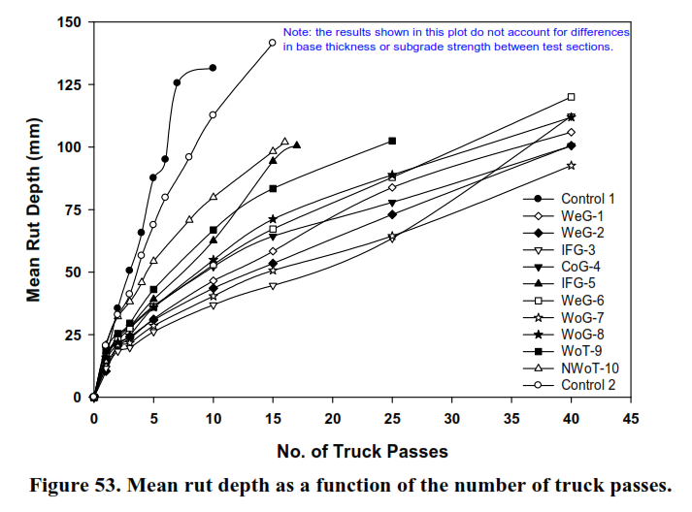
Phase 1 Results
Rapid failure from induced tensile stresses, due to poor compaction and interlock of aggregate.
BX1200
BX1100

Slide 6
Phase 2 Study Design and Execution
Based on the problems with Phase 1, the authors made some modifications to the experimental design. However, they did not address the fundamental issue, which is poor compaction and interlock of the aggregate layer due to improper construction practices.
Constructed subgrade CBR was 1.7%, average thickness of aggregate was 10.9 inches.
Subgrade was constructed in a lined trench, with the top of subgrade at ground level. Geosynthetics were placed over subgrade at ground level. Aggregate base was placed over the geosynthetics.
Reported average CBR of the compacted aggregate was 20% - this did not include the top 2 inches or the bottom 2 inches of the aggregate layer.

Slide 7
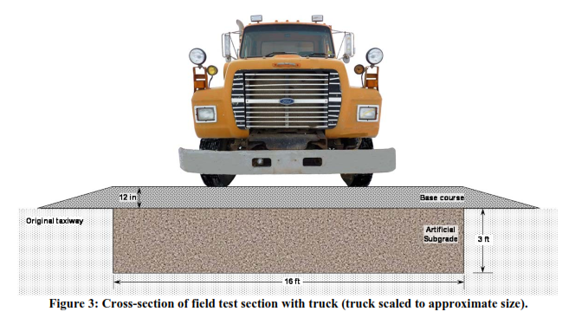
Phase 2 Test Section

Slide 8
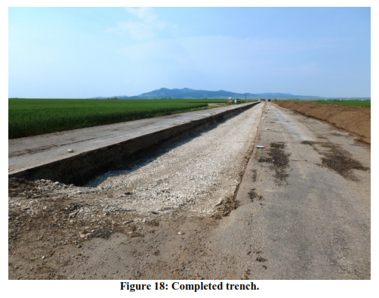
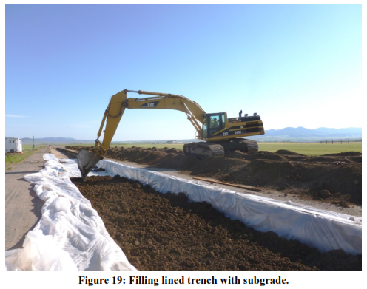
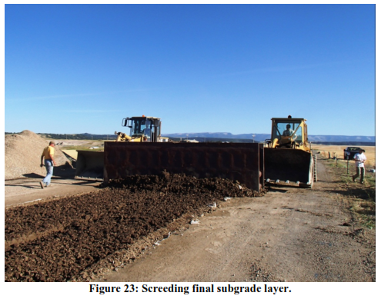
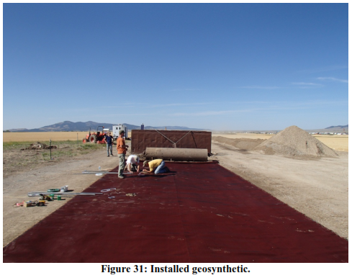
Construction

Slide 9
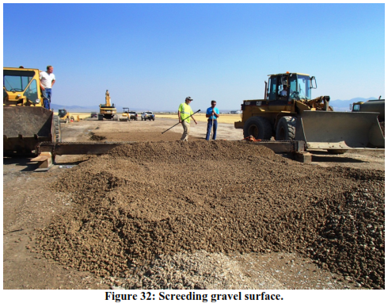
Construction

Slide 10
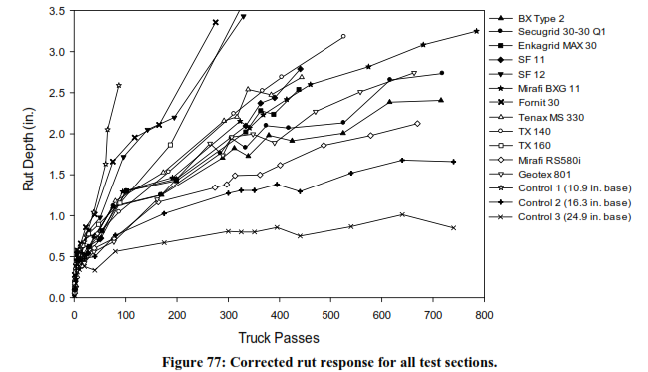
Phase 2 Results

Slide 11
Phase 2 Results
As with Phase 1, the test conditions appear to have caused the geosynthetics to function as tensioned membranes.
The authors themselves make numerous references to tensioned membrane behavior, apparently without understanding the implications for the test results.
The test sections were designed based on an expectation of 2,000 truck passes for a 3 inch rut. Even the “best” result achieved half the expected traffic.
If properly installed, the aggregate thickness should have been adequate to support the expected traffic.

Slide 12
Comparison of Results to G-H Design

Slide 13
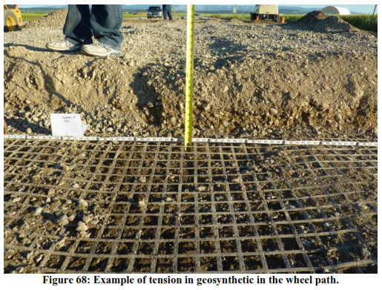
Rutting Failure

Slide 14
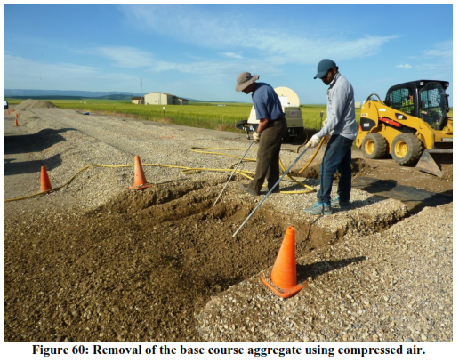
Aggregate Removal Using Compressed Air

Slide 15
Tensar Response
Four page response document (sent Monday) – can be used as needed with customers and distributors
In depth review underway by Technology Group
Industry discussions – all manufacturers need to understand that this is bad for all geosynthetics
Get in front of the study with customers as needed, but do not get out front with broad publicity that calls attention to the report and could look like sour grapes

Slide 16

Competitor Response
We have had some dialogue with Mirafi regarding their promotion of the study – they do not seem to understand the actual ramifications of the results
It appears that they will continue to promote based on cherry-picked quotes
Our response is that if Mirafi endorses this study as representative of RS580i performance, then:
  We should expect an immediate revision to MiraSpec software
  MiraSpec must not have been fully calibrated, since it predicts significantly better performance

Slide 17
Talking Points
The Phase 2 study understates the benefits for all of the geosynthetics tested.
The best explanation for the poor results is that the aggregate layer was not properly installed, resulting in poor compaction and interlock with the geogrids.
This resulted in all of the geosynthetics behaving as tensioned membranes, which favors geotextiles and products with higher TD tensile strength, but does not accurately represent the performance of punched and drawn geogrids.

Slide 18
Talking Points
The Phase 2 results do not agree with:
  Accepted design methodology
  The overwhelming majority of other research in the field
  30 years of experience at Tensar (with over 1 billion square yards installed)
Properly designed geogrid sections rely primarily on the stiffening of the aggregate layer due to mechanical interlock, not tensioned membrane.
The Phase 2 results contradict all design software currently on the market for subgrade stabilization, including SpectraPave4-PRO, MiraSpec (Mirafi), Bi-Design (BOSTD/E’Grid/Hanes/Layfield), and RoadWorX (Syntec).

Slide 19
Questions?

Slide 20

Happy 4th of July!

