Slide 1
Tensar Roadways Means and Methods
July 22, 2014

Slide 2
Day 1 Agenda
7.30 am to 8.30 am Intro to Roadway Products and Applications
8.30 am to 10.30 am Site Evaluation, Subgrade Stabilization Design and Applications
10.30 am to 10.45 am Break
10.45 am to 12.00 pm Pavement Optimization Design and Applications
12.00 pm to 1.00 pm Lunch
1.00 pm to 2.45 pm Pavement Optimization Continued
2.45 pm to 3.00 pm Break
3.00 pm to 4.00 pm Local Research
4.00 pm to 4.30 pm Lead Generation & Execution
4.30 pm to 5.30 pm Specialty Applications – Haul Roads, Crane Pads, Rail, Dimension

Slide 3
Geogrid Basics for Roadway Applications

Slide 4
Geogrid Basics
Performance Mechanisms
  Tensioned Membrane Effect
  Bearing Capacity Improvement
  Lateral Restraint

Slide 5

Mechanisms – Tensioned Membrane Effect
Membrane tension
Vertical
Membrane support
Source: USACOE ETL 1110-1-189
Notes:
Tensile Membrane Effect
Least relevant of the three mechanisms, particularly over strong subgrades
Function of geogrid’s in-plane stiffness characteristics (flexural rigidity)

Slide 6
Mechanisms – Improved Bearing Capacity
Reinforced Shear Surface
Unreinforced Shear Surface
Source: USACOE ETL 1110-1-189
Notes:
Improved Bearing Capacity
Shifting failure envelope from the weak subgrade to the stronger base material
Results in enhanced bearing capacity of the subgrade without soil treatment or undercutting

Slide 7
Mechanisms – Lateral Restraint
Lateral Shear Flow
Lateral Restraint Due to Friction and Aggregate Interlock
Source: USACOE ETL 1110-1-189
Notes:
The concept of confinement or “lateral restraint” is illustrated quite well in the U.S. Army Corps of Engineers document, “USE OF GEOGRIDS IN
PAVEMENT CONSTRUCTION” published in 2003 (it is HIGHLY recommended that the presenter have a hard copy on hand to show to their customer). Figure 1 from this document illustrates the primary reinforcement mechanism as defined by the Corps. Simply stated, lateral restraint is a unique characteristic to geogrid reinforcement as the particle strike-through we just illustrated in the previous slide results in confinement of the aggregate during loading leading to an increase in stiffness of the composite section. This stiffness enhancement leads to an improvement of both vertical and horizontal stress distribution resulting in less pressure being applied to the pavement subgrade.

Slide 8
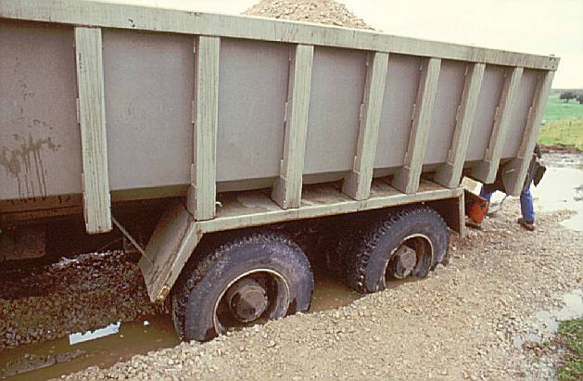

Roadway Applications: Definitions
Used to provide a competent temporary road surface or a stable foundation layer for a permanent road when weak subgrade conditions are encountered.
Subgrade Stabilization
Enhanced performance or thickness reduction of a permanent road when constructed on a relatively firm foundation.
Pavement Optimization

Slide 9
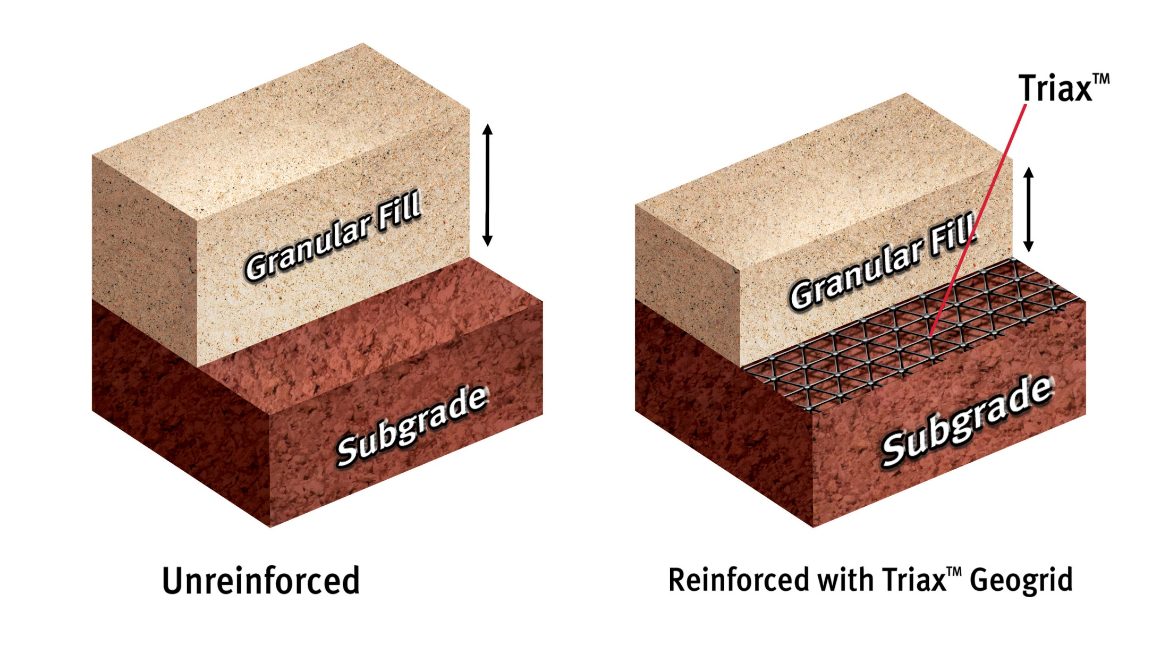
Value Proposition – Subgrade Stabilization
Notes:
Vertical load pushing down on top of the aggregate taking advantage of the stiffness of the grid. Pass out installation guide. Buy a 6-pack of coca cola with clear ring. Bring up volunteer to pull on ring.
Carbon molecules have lined up after stretched
Take out sample of BX grid, see if you can stretch this thing.

Slide 10
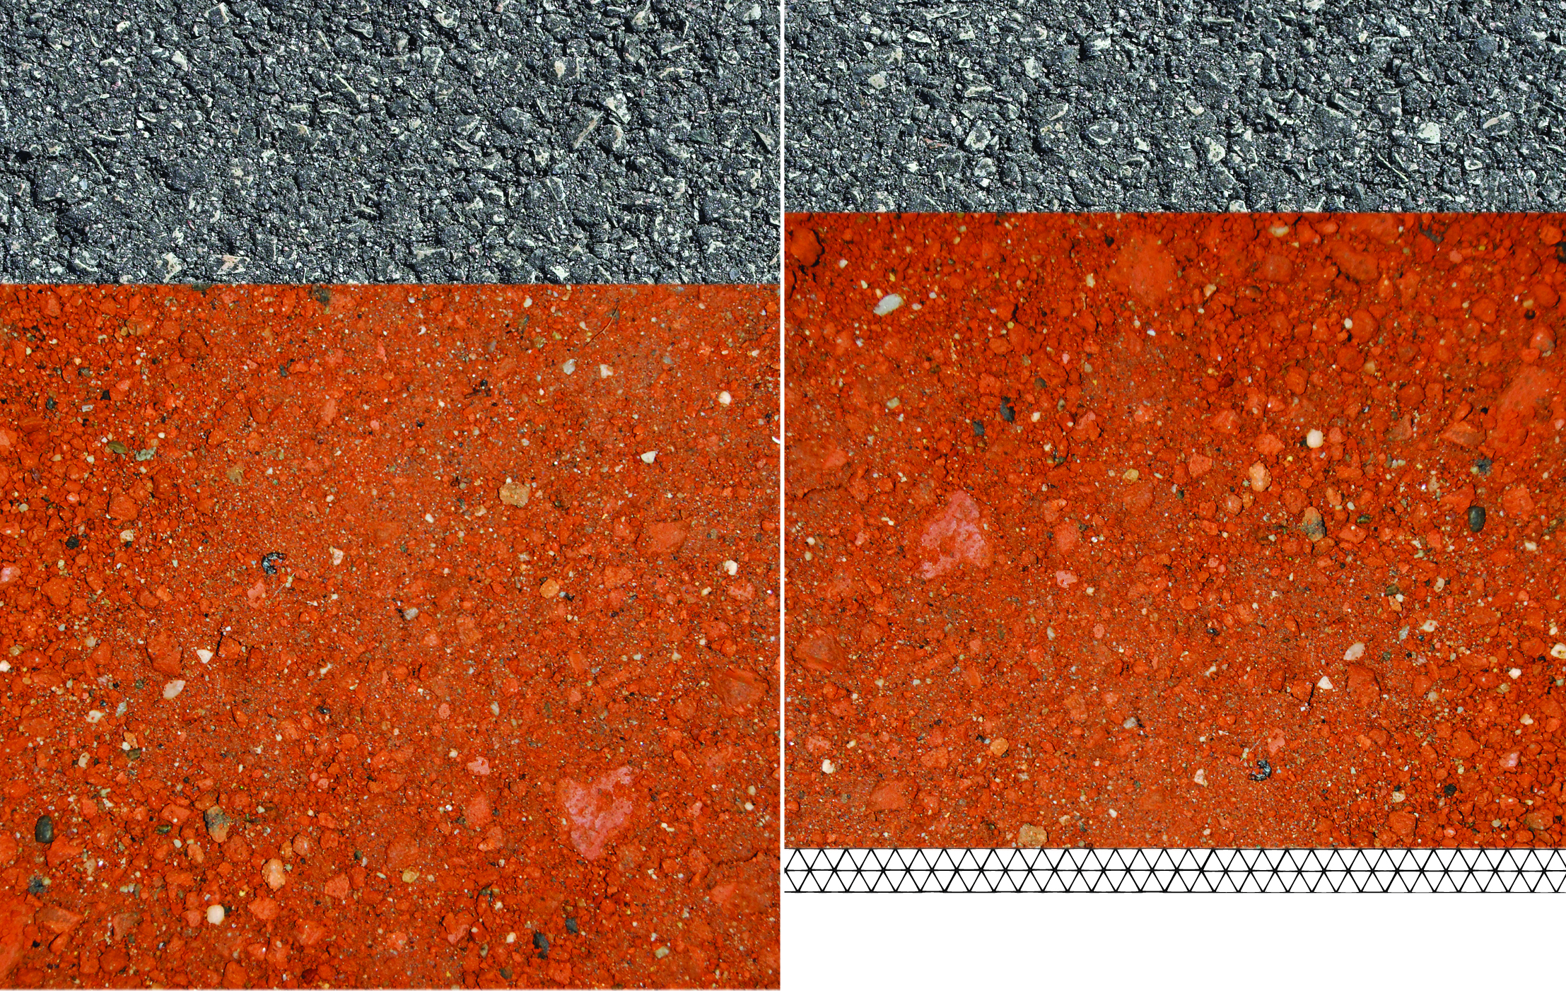
Value Proposition – Pavement Optimization
HMA – 4 inches
HMA – 3 inches
ABC – 10 inches
ABC – 8 inches
Notes:
Vertical load pushing down on top of the aggregate taking advantage of the stiffness of the grid. Pass out installation guide. Buy a 6-pack of coca cola with clear ring. Bring up volunteer to pull on ring.
Carbon molecules have lined up after stretched
Take out sample of BX grid, see if you can stretch this thing.

Slide 11
Site Evaluation, Subgrade Stabilization Design, and Applications

Slide 12
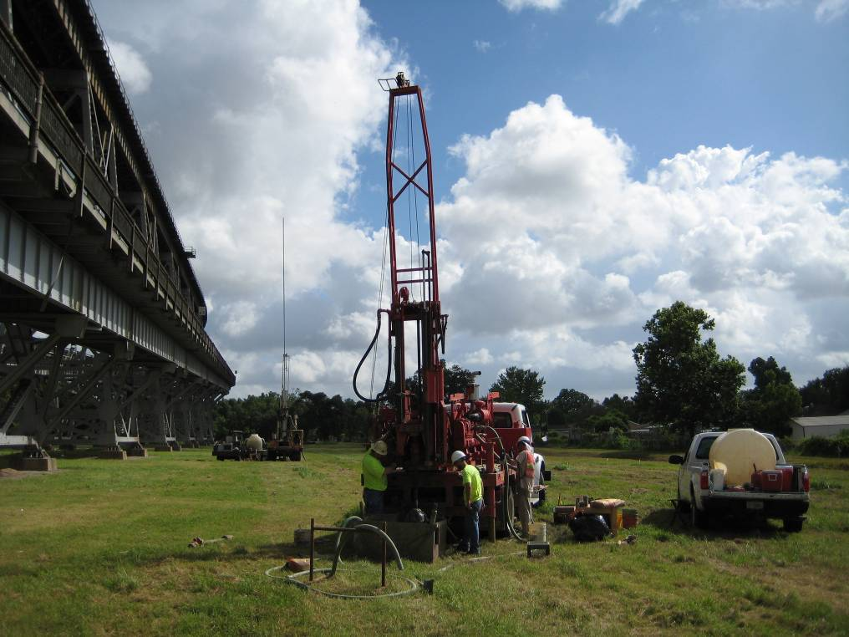
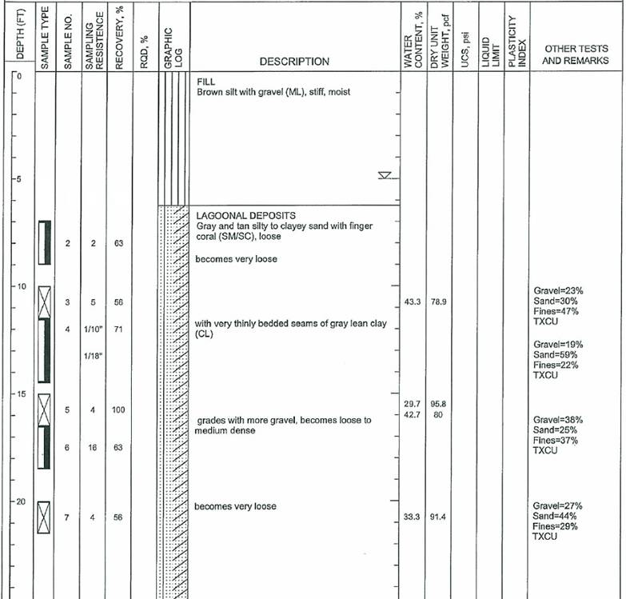
Boring Logs
Notes:
Unfortunately, a typical boring log in a typical soils report indicates undisturbed samples and tests on 5-foot intervals beginning 5 feet below the surface. That’s because no one has instructed them to do anything differently and it’s convenient for them to sample and test soil at depth when adding 5-foot auger flights.
For working surfaces, we’re normally most interested in the top 1-1/2 to 3 feet for wheeled equipment, depending on its size, and top 5 feet for tracked cranes. In this range there is generally no in-place – or as geotechnical engineers say, in-situ – ground support information on boring logs other than soil type and perhaps moisture content.

Slide 13
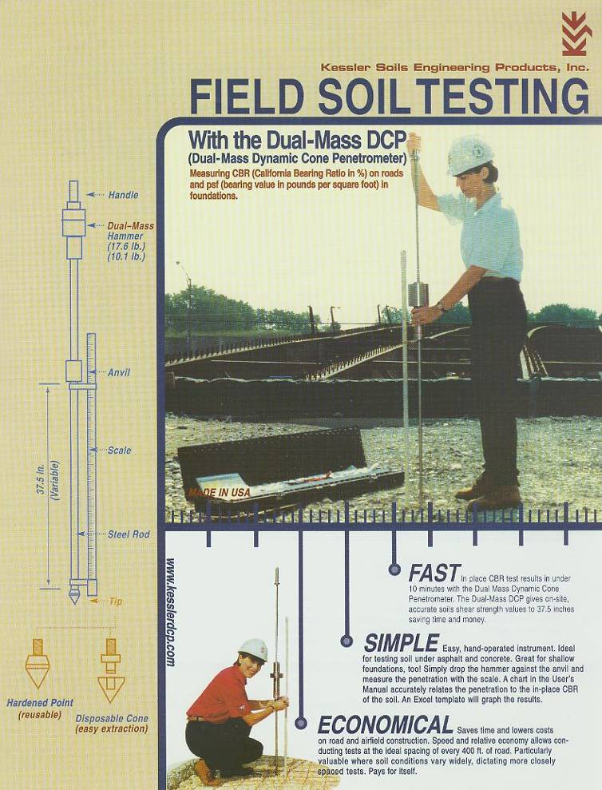
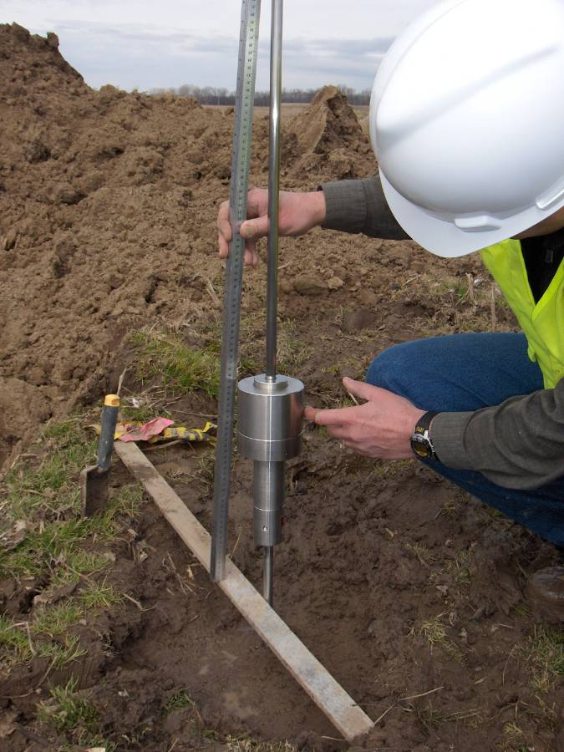
Field Tests
DCP Demo
Notes:
Fortunately, there are relatively simple tests that can be performed in the field to quantify surface and near-surface ground support characteristics. The most common of these are penetration tests that correlate the soil’s resistance to penetration with its shear strength.
Such a handheld device that KECo employs is shown here: a Dynamic Cone Penetrometer, or DCP for short. The test is typically conducted by two people and produces data down to 3 feet rapidly and inexpensively.
DCP correlations aren’t particularly precise which means if we really want to quantify soil shear strength, we should at least supplement DCP tests with tests that measure shear resistance directly.

Slide 14
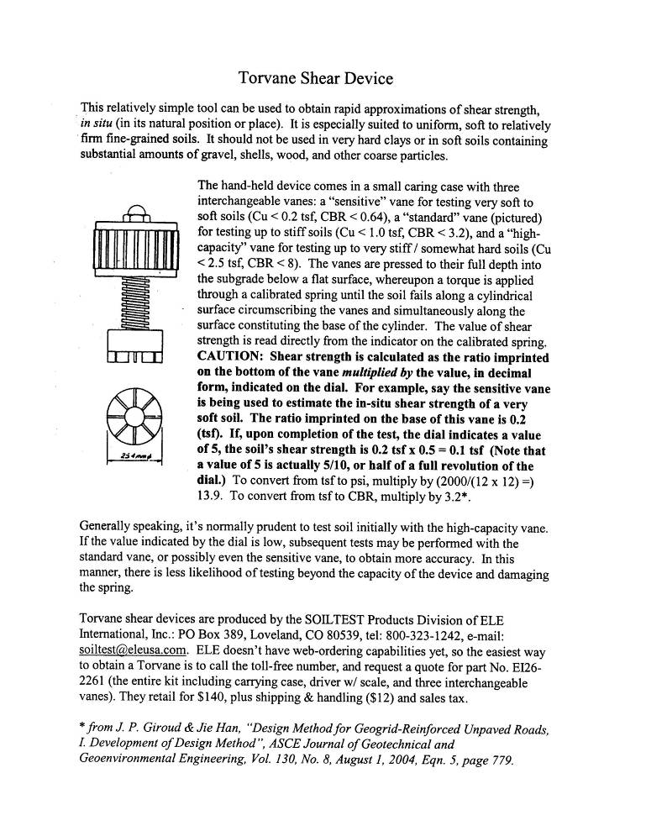
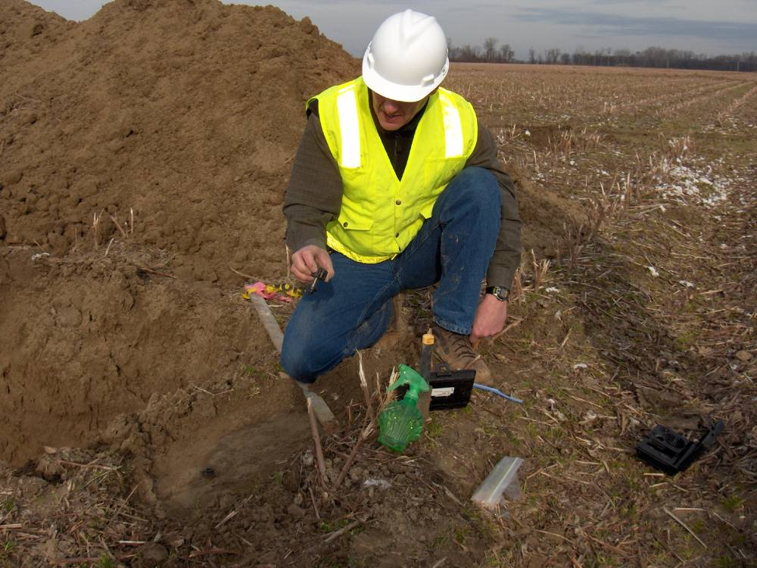
Vane Shear Testing
Torvane Demo
Notes:
The most common means of measuring soil shear strength directly, by hand, in the field are vane shear tests. A pocket-sized device called a Torvane, pictured here, is especially suited to uniform, soft to relatively firm fine-grained soils. It should not be used in very hard clays or in soft soils containing substantial amounts of gravel, shells, wood, and other coarse particles. The vanes are pressed to their full depth into an undisturbed flat surface, and then a torque is applied through a calibrated spring until the soil fails along a cylindrical surface circumscribing the vanes and simultaneously along the surface constituting the base of the cylinder. Soil shear strength is calculated as the ratio imprinted on the bottom of the vane multiplied by the value, in decimal form, indicated on the dial atop a calibrated spring.

Slide 15
Early Applications and Design Methods for Geosynthetics
Notes:
Text Specs:
Verdana
Title [22]
Title [18]
Subtitle [16]

Slide 16
Objectives
Review and discuss early design methods and practices for the use of geosynthetics
  Giroud-Noiray
  USACE ETL 1110-1-189
  Base Course Reduction Factor design
Identify key findings and concepts that apply to current methods and practices
  Performance mechanisms
  Empirical calibration and validation using full-scale testing
  Method limits and constraints
  Use of base course reduction factors

Slide 17
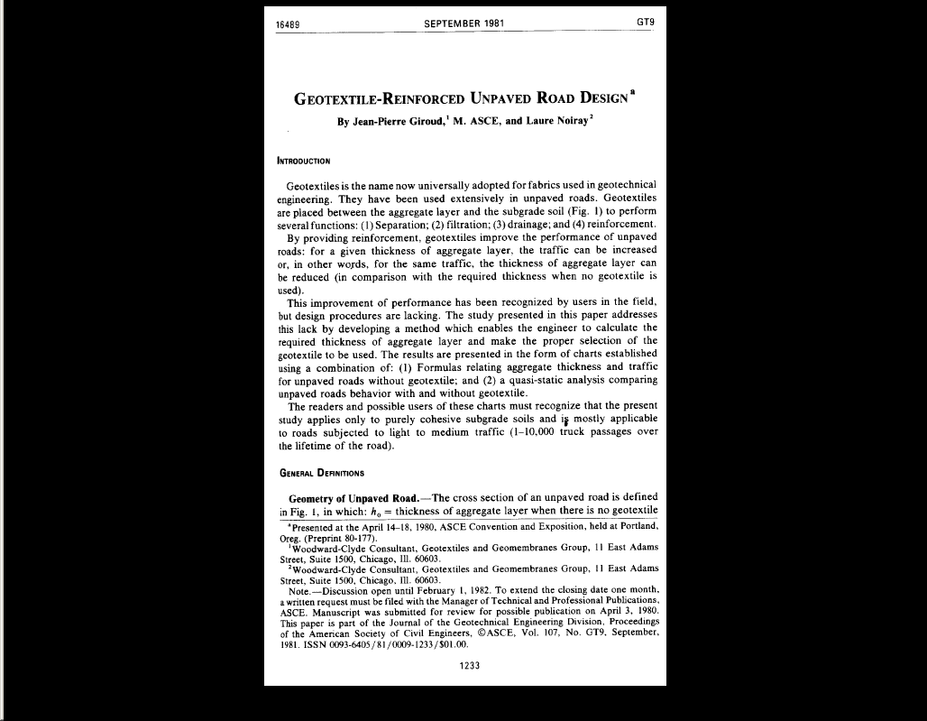
Giroud-Noiray Key Points
Quantified Tensioned Membrane Effect for geotextiles
Intended for low volume, gravel-surfaced roads over soft subgrades
Defined performance in terms of rut depth failure mechanism
Combined theoretical analysis with full-scale empirical testing for calibration and validation
Specific to geotextiles, not geogrids
Static analysis is the basis for the Giroud-Han design method
Notes:
Text Specs: Verdana Font
Title Bold [28]
Bullet 1 [24]
Bullet 2 [20]
Bullet 3 [18]
Bullet 4 [16]
Caption Bold [14]

Slide 18
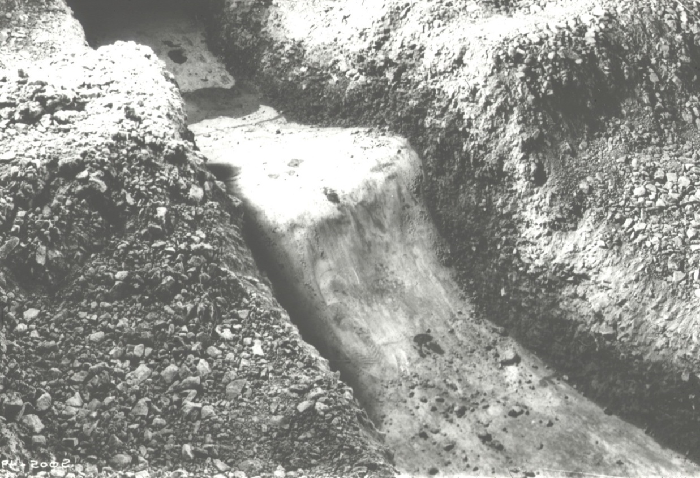
Giroud-Noiray Performance Mechanism
Membrane Tension
Vertical Membrane Support
Notes:
http://environment.uwe.ac.uk/geocal/SoilMech/basic/stiffness.htm

Slide 19
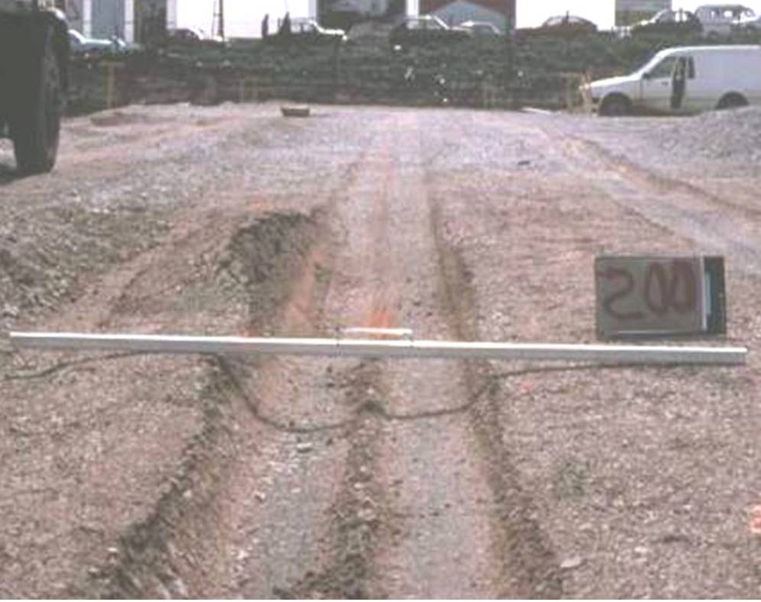
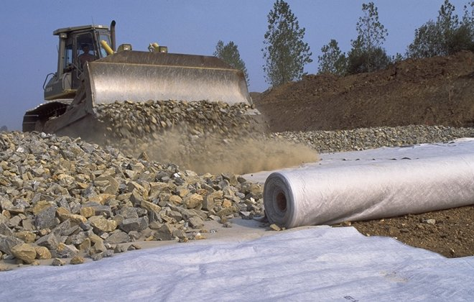
Giroud-Noiray Design Limitations
Limited to 10,000 passes
No minimum aggregate depth
Results are independent of geotextile tensile strength
Results negligible to rut depths ≤ 3 inches (the tensioned membrane effect is irrelevant until significant rutting occurs)

Slide 20
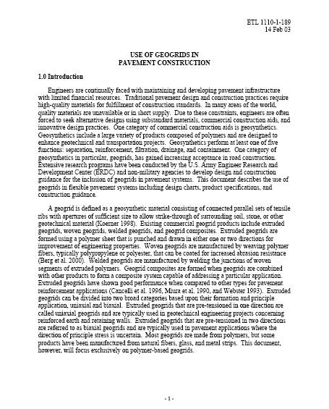
USACE ETL 1110-1-189 (Gravel-Surfaced Roads) Key Points
Intended for low volume roads – design charts are for 18 kip axle & 1,000 passes
Identified 3 primary geosynthetic mechanisms:
  Bearing Capacity Improvement
  Lateral Restraint (interlock)
  Tensioned Membrane Effect
Empirical approach using design charts
Bearing capacity factors established based on USACE full-scale testing:
  Unstabilized – 2.8
  Geotextile – 3.6
  Geogrid – 5.8
Subgrade bearing capacity, CN_{c}, used to determine required thickness for gravel roads
Associated method for asphalt-surfaced roads
Notes:
Text Specs: Verdana Font
Title Bold [28]
Bullet 1 [24]
Bullet 2 [20]
Bullet 3 [18]
Bullet 4 [16]
Caption Bold [14]

Slide 21
ETL Design Charts
4.8 psi
Notes:
Text Specs: Verdana Font
Title Bold [28]
Bullet 1 [24]
Bullet 2 [20]
Bullet 3 [18]
Bullet 4 [16]
Caption Bold [14]

Slide 22
Base Course Reduction Factor Design
For design methods that were not originally developed for use with geosynthetics, the benefit of using a geogrid can be accounted for using a Base Course Reduction Factor (BCR)
Most frequent use of BCR approach currently is for very heavy or unusual design loadings on heavy duty haul roads
BCR factors are based on the experience and discretion of the designer – typical BCR factors range from 25% to 60% for gravel-surfaced roads of various types
BCR factors are occasionally applied to asphalt-surfaced pavements, but must be used with extreme caution. More accurate and precise methods are available in most cases (e.g., AASHTO 1993 / SpectraPave4-PRO design methodology)

Slide 23
Early Methods Key Points
Understanding of geosynthetic performance mechanisms
Importance of full-scale testing for method calibration and performance validation
Design limits and intended conditions must be understood
Bearing capacity factors demonstrate performance differences among geosynthetic types

Slide 24
Giroud-Han Design Method
Notes:
Text Specs:
Verdana Font
Title Bold [22]
Title [18]
Subtitle [16]

Slide 25

ASCE Publication & Peer Review
  I. Development of Design Method (Aug 2004)
  II. Calibrations & Applications (Aug 2004)
  Discussion of… (April 2006)

Slide 26

FHWA Design/Usage Protocol
USFS Method (1977) – Bearing Capacity Method: Unpaved
USACOE (2003) – Bearing Capacity Method: Unpaved
Giroud-Han (2004) – Serviceability Method: Unpaved

Slide 27





Design Theory – Giroud Han (2004)
Limit Equilibrium Bearing Capacity Analysis
Adopted from design theory presented in Giroud Noiray except:
  Utilizes a single equation applicable for all design cases
  Incorporates unique bearing capacity factors, N_{c}, for all design cases
  Varies stress distribution angle, α, based upon geosynthetic type
  Considers quality of aggregate base material and stiffness ratio_{base-subgrade}
Stress
E₁ > E₂
E₂
Stress in uniform soil
Notes:
Text Specs: Verdana Font
Title Bold [28]
Bullet 1 [24]
Bullet 2 [20]
Bullet 3 [18]
Bullet 4 [16]
Caption Bold [14]

Slide 28
Design Theory – Giroud Han (2004)
Giroud Han method uses the same Giroud Noiray equation for unreinforced and reinforced unpaved roads
JP Giroud - International Conference on Geosynthetics 9 – Cancun, Mexico

Slide 29
Design Theory – Giroud Han (2004)
Bearing capacity factor, N_{c} , is theoretically justified and depends on the type of reinforcement:
JP Giroud - International Conference on Geosynthetics 9 – Cancun, Mexico

Slide 30

Design Theory – Giroud Han (2004)
The stress distribution angle, α, depends on:
  number of traffic passes
  subgrade and base properties
  geosynthetic properties
JP Giroud - International Conference on Geosynthetics 9 – Cancun, Mexico

Slide 31
Design Theory – Giroud Han (2004)
where:
  = stress distribution angle
  N = number of passes
  R_{E} = modulus ratio of base – subgrade
  C = calibration factor
where:
  J = geogrid aperture stability modulus (N-m/°)
JP Giroud - International Conference on Geosynthetics 9 – Cancun, Mexico

Slide 32
Design Theory – Giroud Han (2004)
  h = aggregate base thickness
  r = radius of tire contact area
  N = number of axle passes
  CBR_{bc} = agg base CBR
  CBR_{sg} = subgrade CBR
  P = Wheel load
  s = rut depth
  f_{s} =factor equal to 75 mm rut depth
  N_{c} =bearing capacity factor
  f_{c} =factor between undrained cohesion and CBR of subgrade
  J = aperture stability modulus of geosynthetic
Solve iteratively for h, aggregate fill thickness

Slide 33
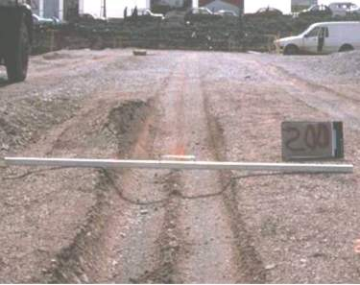
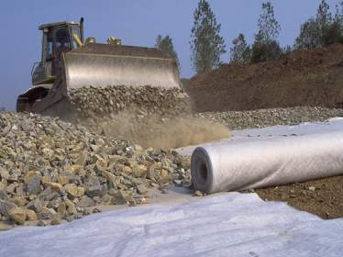
Limitations – Giroud Han
Limited to 10,000 passes (original research)
SP4-PRO limit = 100,000 passes (based on Tensar research and experience)
Minimum aggregate depth = 4” (original research)
SP4-PRO min. aggregate = 6” (based on experience and constructability)
Upper constraint for:
  Axle Loading ≤ 40 kips
  Rutting ≤ 3.0 inches
  Subgrade CBR ≤ 5.0
Method Calibration required for ALL product types

Slide 34
Giroud Han Product Calibration

Slide 35
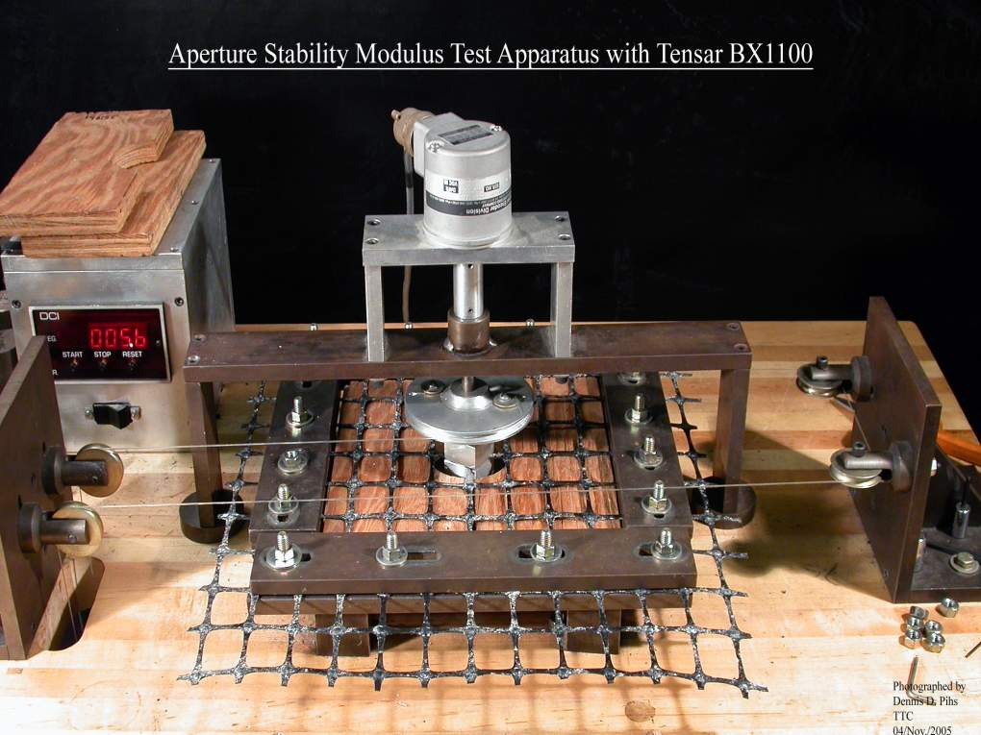
Calibration – Giroud Han (2004)
“It (aperture stability) is a direct measure of the in-plane stiffness and stability of the ribs and junctions of the geogrid.”
“The method was calibrated using data for stiff biaxial geogrids with aperture stability modulus of 0.32 and 0.65 N-m/deg”*
*Geosynthetic Design & Construction Guidelines – FHWA NHI-07-092 (2008)

Slide 36
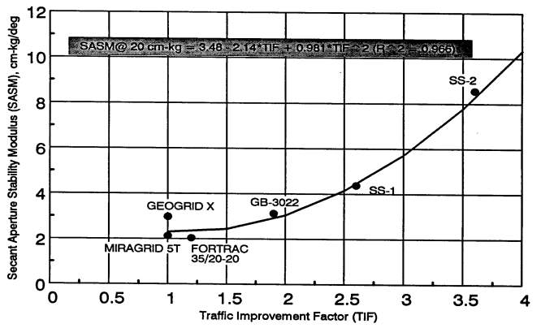
Calibration – Giroud Han (2004)
Good correlation with performance for biaxial geogrids as shown by Webster’s full-scale tests (1992).
SASM@20cm-kg = 3.48 – 2.14*TIF + 0.981*TIF² (R² = 0.966)

Slide 37
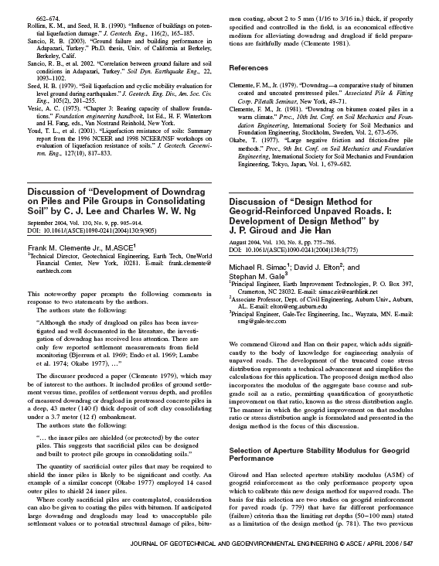
Calibration – Giroud Han (2004)
Discussion of “Design Method for Geogrid-Reinforced Unpaved Roads. I: Development of Design Method” by J. P. Giroud and Jie Han
  ASCE Geotechnical Journal (2006)
  Authors challenged on:
    Non-generic nature of method
    Not calibrated to geosynthetic tensile properties

Slide 38
Calibration – Giroud Han (2004)
Desired performance
Performance (TBR)
Minimum tensile strength
Tensile strength @ 5% strain

Slide 39
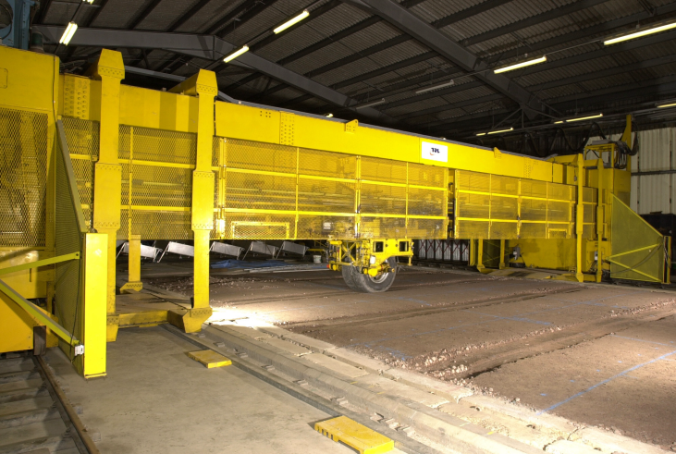
Calibration – Giroud Han (2004)
Watts et al. (2004)

Slide 40
Calibration – Giroud Han (2004)
TBR data from Watts et al. (2004)

Slide 41


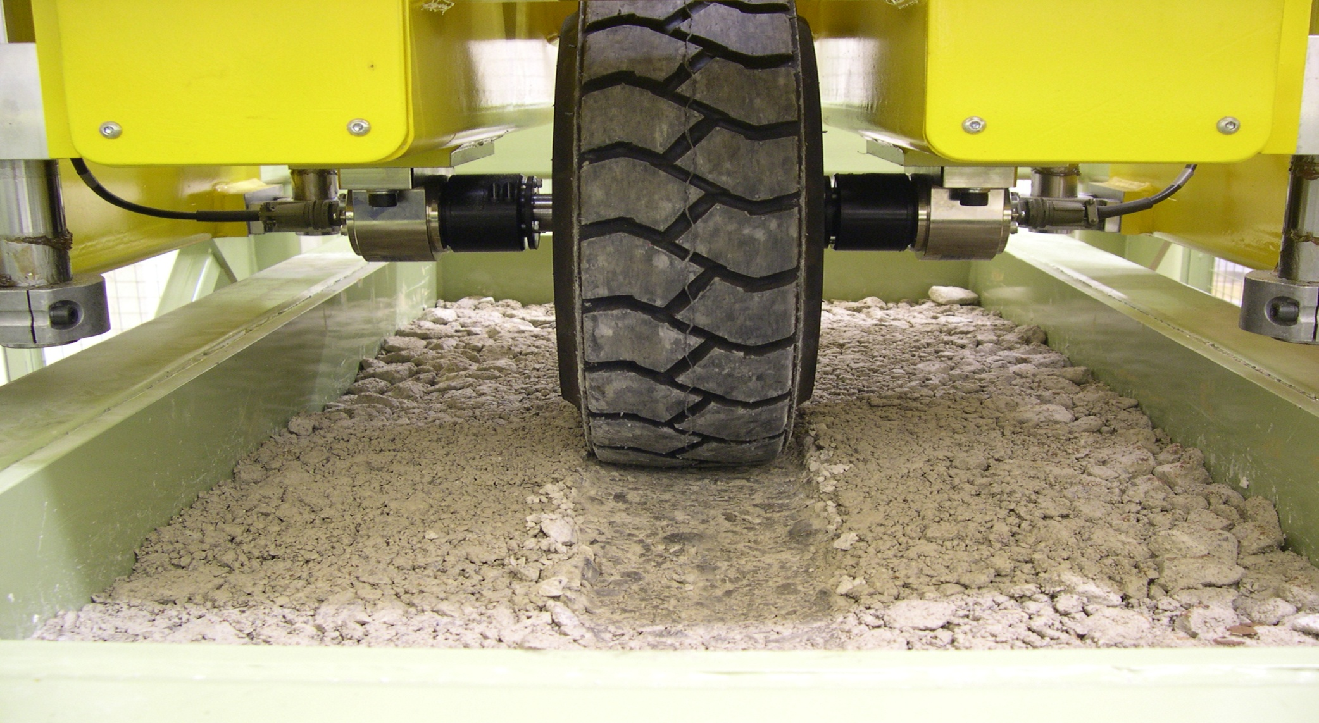
Small-scale Trafficking – Tensar (UK)
Notes:
41

Slide 42
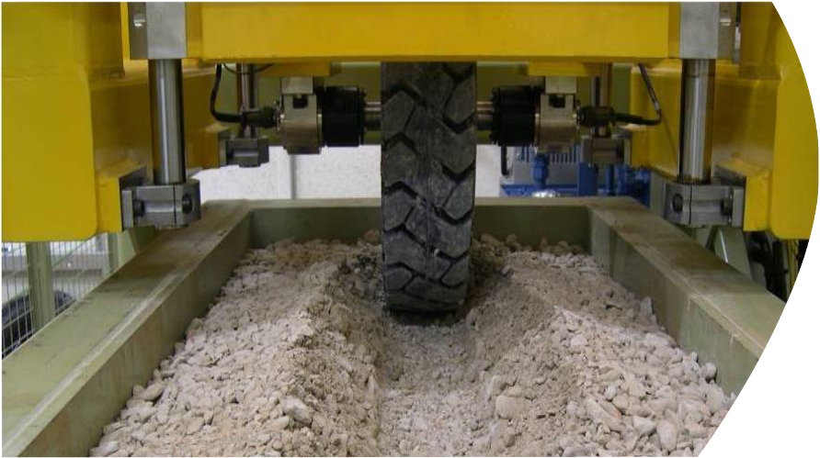
Aggregate Rutting Profiles - Unstabilized
Notes:
42

Slide 43
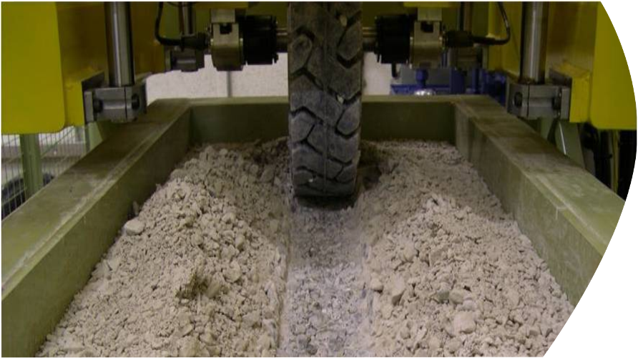
Aggregate Rutting Profiles – Tensar BX
Notes:
43

Slide 44
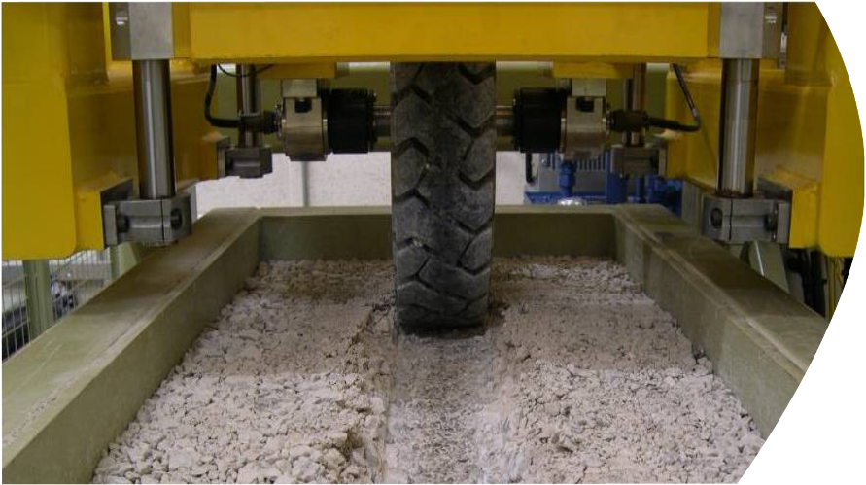
Aggregate Rutting Profiles – Tensar TriAx™
Notes:
44

Slide 45
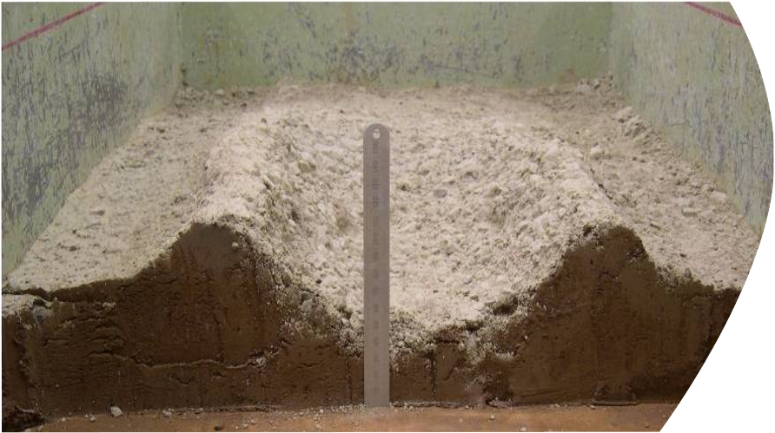
Subgrade Rutting Profiles - Unstabilized
Notes:
45

Slide 46
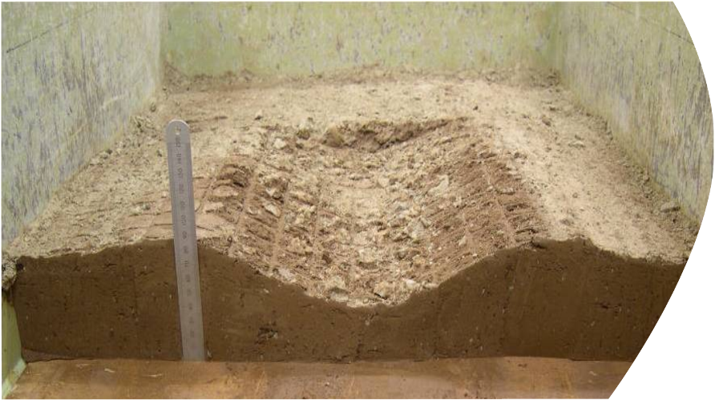
Subgrade Rutting Profile - Tensar BX
Notes:
46

Slide 47
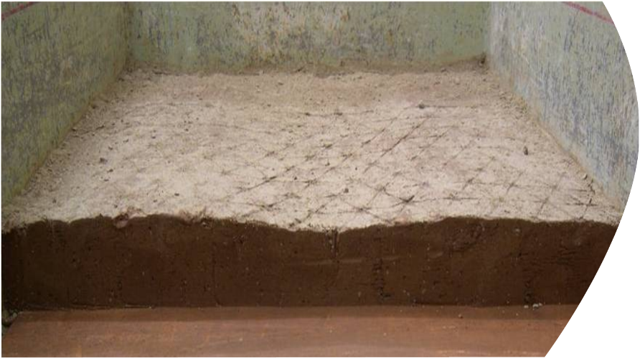
Subgrade Rutting Profile - Tensar TriAx™
Notes:
47

Slide 48
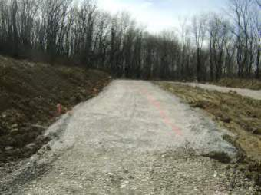
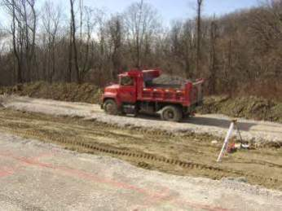
Full-Scale Field Study
Purpose / Objective:
Validate performance of Triaxial Geogrid in a representative field study.
Attempt to differentiate between Triaxial and BX in the following ways:
  Compactive effort and time required to achieve serviceable traffic surface.
  Resistance to surface deformations from trafficking.
  Magnitude of subgrade deformations from trafficking.

Slide 49
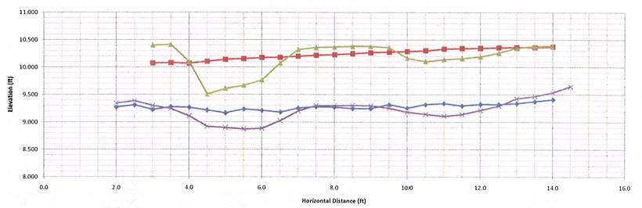
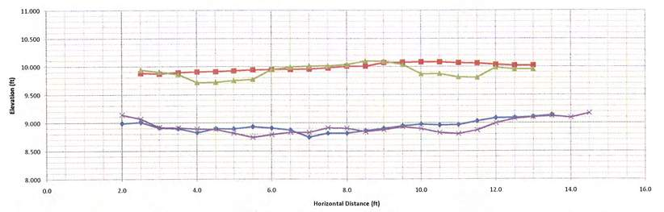
Full-Scale Field Study
Biaxial
CBR 0.4
TriAx®
CBR 0.4

Slide 50
A Recent Example – TX130S
Small Scale Trafficking Tests
Field Performance Validation

Slide 51
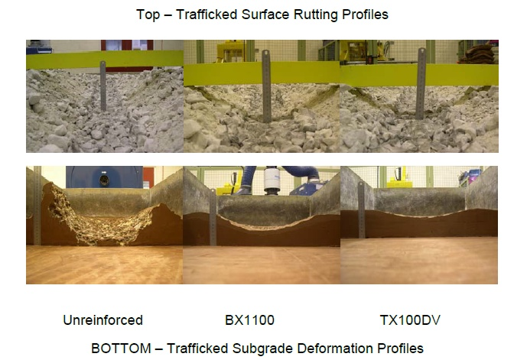
Small Scale Trafficking Performance
TX130S

Slide 52
Field Performance Validation Study
Validation against SP4 design output
“Typical” design case – CBR 2, 1200 passes, 18 kip axle
Side by side with BX1100 to validate design case with known product and benchmark performance
10 inch and 15 inch aggregate sections tested

Slide 53
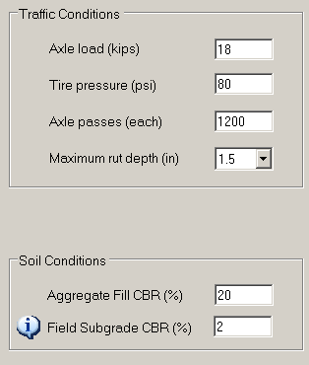
Analysis for Full Scale Traffic Conditions

Slide 54
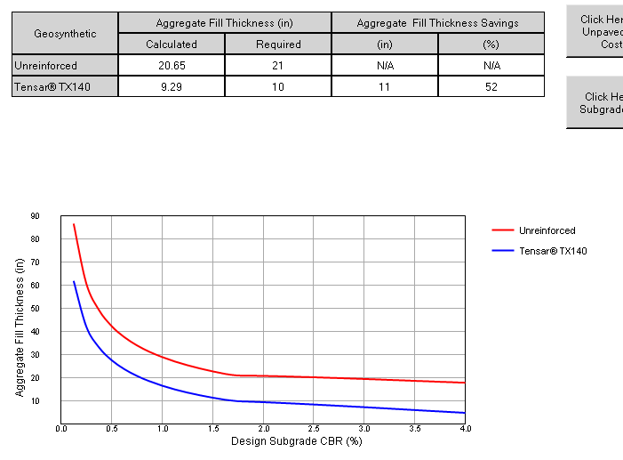
SpectraPave4® PRO Analysis
1.5” rut 2% CBR

Slide 55
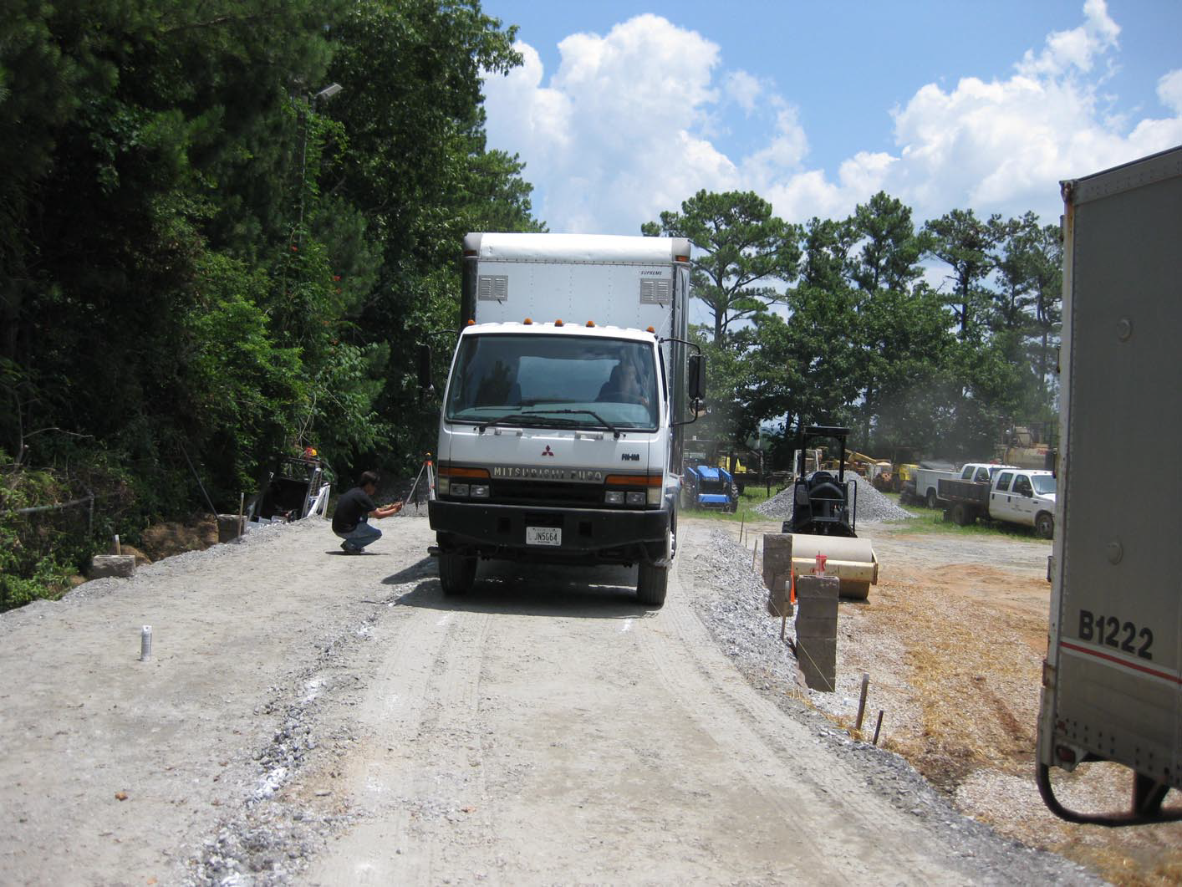
Trafficking

Slide 56
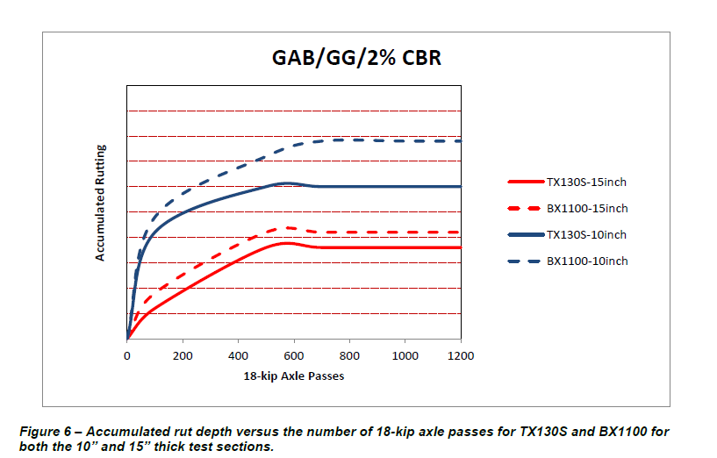
Results

Slide 57
TX130S Validation Summary
Based on G-H Design at 1.5” rut criteria and field conditions during the test:
  TX140 Would Require 10” GAB
TX130S Exceeds TX140 Design
Performance validated against BX1100

Slide 58
Subgrade Stabilization Exercise
Contractor must construct a paved road in the area shown
Subgrade will not pass proof roll
Rough graded elevation is at designed top of subgrade
Aggregate cost = $18.00/ton in place
Undercut cost = $8.00/cy
Geogrid cost = $1.50/sy TX140, $3.00/sy TX160
What solution would you offer?

Slide 59
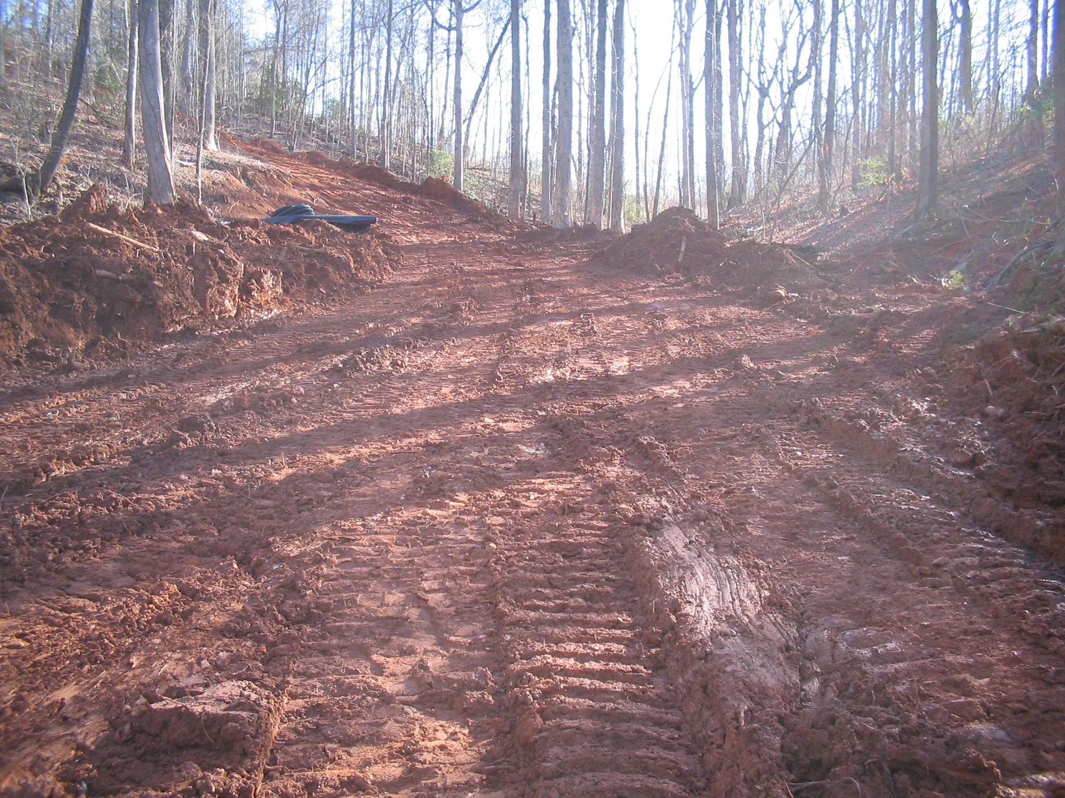
Subgrade Stabilization Exercise

Slide 60

AASHTO (1993) Design Method for Flexible Pavements
Notes:
Text Specs:
Verdana
Title [22]
Title [18]
Subtitle [16]

Slide 61

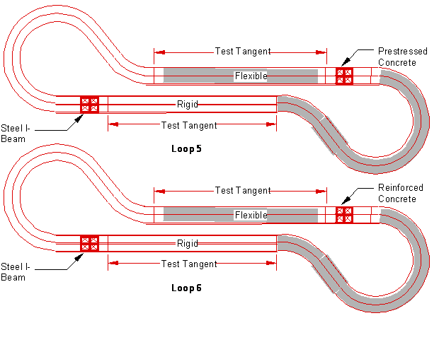
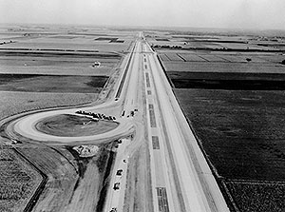
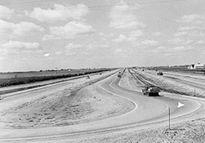
AASHTO (‘93) Approach
Empirically based design method
  Testing undertaken in Ottawa, IL
  Circa 1960

Slide 62
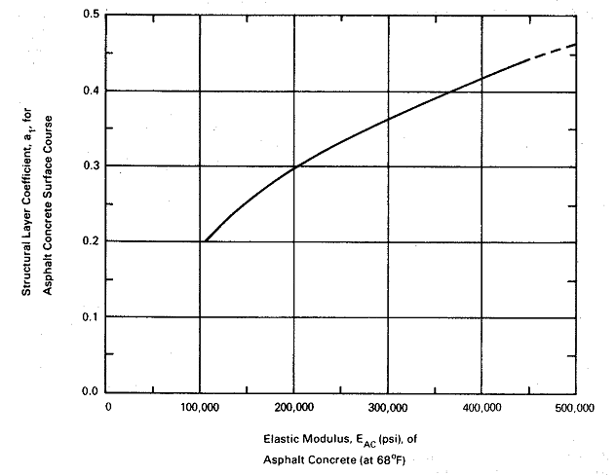
AASHTO (‘93) Approach
Asphalt Layer

Slide 63
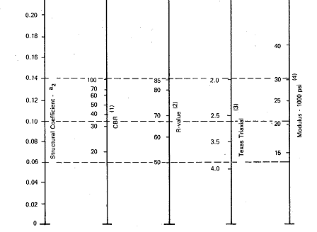
AASHTO (‘93) Approach
Aggregate Base Layer

Slide 64
AASHTO (‘93) Approach
Structural Number
a = 0.40
SN = 4 x 0.40 = 1.60
4”
ACC1
a = 0.14, m = 1.0
SN = 10 x 0.14 x 1.0 = 1.40
ABC
10”
Overall SN = 1.60 + 1.40 = 3.00

Slide 65
AASHTO (‘93) Approach
W₁₈ = Allowable ESALs
Z_{R} = Standard normal deviate = -1.645 (for 95% reliability)
S_{o} = Standard deviation = 0.49
SN = Structural number = 3.00
ΔPSI = Change in serviceability = 4.2 – 2.0 = 2.2
M_{R} = Subgrade resilient modulus = 5,000 psi
W₁₈ = 117,000 ESALs (Unreinforced)

Slide 66
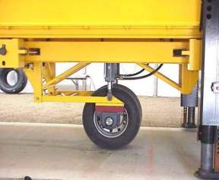
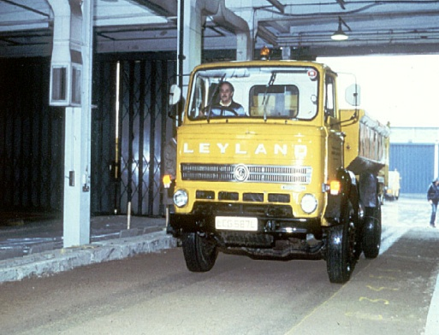
Inclusion of Geogrids
AASHTO Standard of Practice R50-09
Deformation
control
reinforced
1 inch
Number of passes
200,000
1,000,000
Traffic Benefit Ratio (TBR)
  No. passes for given deformation in reinforced section
  No. passes for given deformation in control section
TBR = 1,000,000/200,000 = 5

Slide 67
Inclusion of Geogrids
AASHTO Standard of Practice R50-09
TBR
CBR = X
CBR = 2X
CBR = 3X
Pavement Thickness

Slide 68
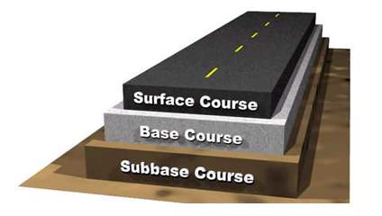
Benefit of Tensar Geogrid
TriAx® Geogrid layer coefficients are dynamic factors that vary depending on:
  Aggregate thickness
  Subgrade Resilient Modulus
SN = a₁D₁ + a₂D₂m₂ + a₃D₃m₃

Slide 69
Tensar Pavement Optimization Design Method

Slide 70
SP4 Pro Modified Layer Coefficients
Tensar Confidential – Do Not Reproduce or Distribute

Slide 71
AASHTO (‘93) Approach
Structural Number
a = 0.40
SN = 4 x 0.40 = 1.60
4”
ACC1
a = 0.23, m = 1.0
SN = 10 x 0.23 x 1.0 = 2.30
ABC
Overall SN = 1.60 + 2.30 = 3.90
10”
TX5

Slide 72
General AASHTO (‘93) Approach
W₁₈ = Allowable ESAL’s
Z_{R} = Standard normal deviate = -1.645 (for 95% reliability)
S_{o} = Standard deviation = 0.49
SN = Structural number = 3.90
ΔPSI = Change in serviceability = 4.2 – 2.0 = 2.2
M_{R} = Subgrade resilient modulus = 5,000 psi
W₁₈ = 686,000 ESAL’s (Tensar TX5 Geogrid reinforced)

Slide 73
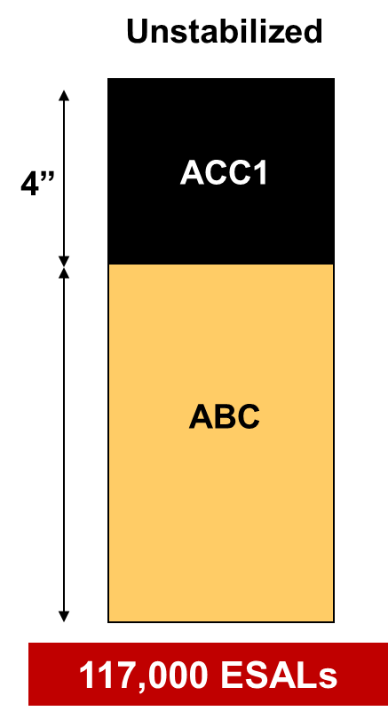
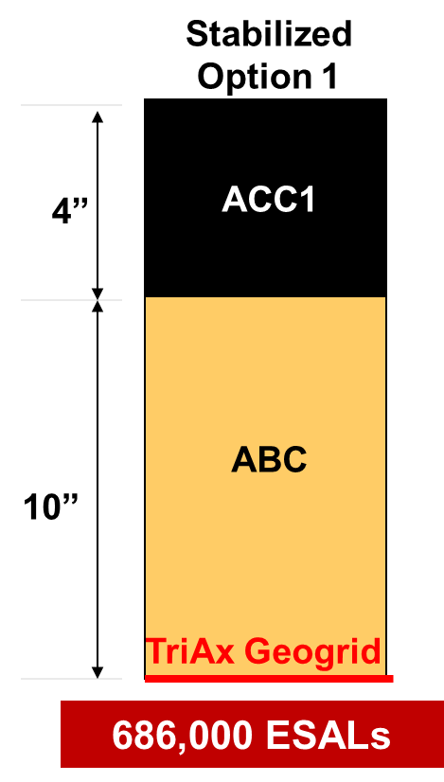
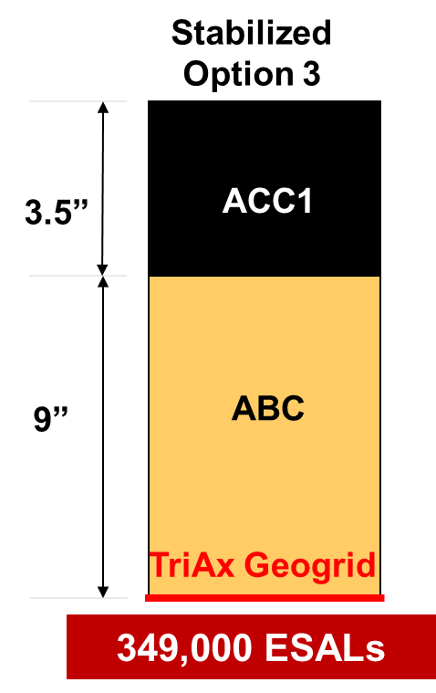


Pavement Optimization
Conventional Design
Maximum Life
Minimum Construction Cost
Equivalent Cost

Slide 74
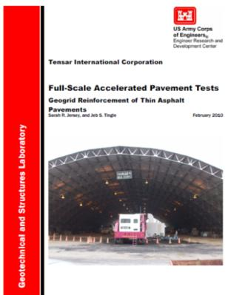
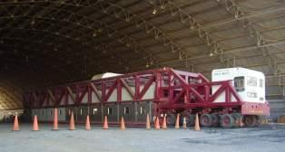
Full Scale APT - USACE

Slide 75




Full Scale APT

Slide 76

Related Technologies
Intelligent Compaction

Slide 77

Intelligent Compaction Research

Slide 78
TX160 geogrid reduced permanent cyclic deflection subject to 100 psi cyclic stress.
TX160 Stabilized <0.2”
Unstabilized ~ 1”

Slide 79
SpectraPave4 PRO™ Version 4.6
Design Methodology and Software
Tensar International Corporation

Slide 80
Roadway Section Design Methodologies
Pavement Optimization: AASHTO Flexible Pavement Design
  Applicable to asphalt-surfaced roads (related method available for gravel-surfaced roads)
  Empirical method (AASHTO 93) based on AASHO Road Test and subsequent research – basis for SpectraPave4-PRO
  Geosynthetics included in compliance with AASHTO R50-09
  Geogrid effect quantified using modified layer coefficient for Mechanically Stabilized Layer (MSL)
  AASHTO MEPDG uses mechanistic-empirical approach – geosynthetic inclusion currently under development

Slide 81


Performance Validation Testing –
Full Scale APT

Slide 82
The Effects of Pavement Section Geometry
The benefit of geogrid in the pavement section varies based on:
  Asphalt thickness
  Aggregate thickness
  Subgrade support
  Geogrid type
Early software (including SpectraPave and SpectraPave2) used constant Traffic Benefit Ratios (TBRs) based on limited experience and research – this was the best approximation possible but was understood as such
SpectraPave4-PRO is the only available software that uses variable TBR (via modified layer coefficients) based on full scale testing and pavement section geometry
SpectraPave4-PRO also considers the differences in failure mechanisms with varying AC thickness

Slide 83

ARA-Berg SpectraPave4-PRO Peer Review

Slide 84
Modulus-Based Method for Evaluating Subgrade Support
In cases where a flexible pavement structure is to be built over a soft subgrade (CBR < 3.0), Tensar recommends that the subgrade be stabilized as the first step, followed by the design of the pavement section.
Prior to SpectraPave4-PRO v. 4.6, we used Giroud-Han as a proxy method to estimate the required Subgrade Stabilization layer – using a standard design case, the stabilized subgrade is assumed (conservatively) to have a CBR of 6.0.
The Modulus Based Method in v. 4.6 uses new research to determine the in situ effective modulus at the top of the stabilized subgrade, based on the stabilization layer and the overlying pavement section.
The effective modulus values are based on research conducted by Dr. David White (Iowa State) and Dr. Jie Han (Univ. of Kansas) using Automated Plate Load Testing (APLT) and other methods.

Slide 85




Pavement Foundation
Asphalt Concrete
Aggregate Base
σ
Stabilized Subgrade
MSL
Subgrade

Slide 86
Including Generic Geogrid Products
Biaxial Geogrid Module allows analysis of designs using generic biaxial punched and drawn geogrid
Design output is based on performance curves that are normalized to be representative of the wide variety of materials available
Subgrade Stabilization module allows analysis of geotextile stabilization in accordance with Giroud-Han
Flexible Pavement analysis allows reduction of aggregate layer only
For specific, non-Tensar products, deviation from generic results should only be considered based on full scale performance data and product calibration for those products

Slide 87
Pavement Optimization Exercise
Large parking lot with light duty and heavy duty pavement sections
Light duty pavement area = 7 acres
Heavy duty pavement area = 2500 ft x 20 ft
Asphalt wearing course - $85.00/ton in place
Asphalt binder - $70.00/ton in place
Graded Aggregate Base - $18.00/ton in place
TX5 geogrid - $3.00/sy

Slide 88
Light Duty Pavement Section
1 1/2”
ACC1
a = 0.42
2”
ACC2
a = 0.40
9”
ABC
a = 0.14, m = 1.0

Slide 89
Heavy Duty Pavement Section
1 1/2”
ACC1
a = 0.42
2 1/2”
ACC2
a = 0.40
10”
ABC
a = 0.14, m = 1.0

Slide 90
Pavement Optimization Exercise
The contractor has the job and is looking for opportunities to increase his profitability
How should we analyze this opportunity?
What can we offer the contractor?

Slide 91
Light Duty Pavement Section - Stabilized
1”
ACC1
a = 0.42
2”
ACC2
a = 0.40
6”
ABC
a = 0.14, m = 1.0
TX5
Unstabilized Calculated Traffic = 57,000 ESALs
Stabilized Calculated Traffic = 63,000 ESALs

Slide 92
Heavy Duty Pavement Section - Stabilized
1”
ACC1
a = 0.42
2”
ACC2
a = 0.40
8”
ABC
a = 0.14, m = 1.0
TX5
Unstabilized Calculated Traffic = 125,000 ESALs
Stabilized Calculated Traffic = 152,000 ESALs

Slide 93
Cost Comparison
Original Design
Light Duty Pavement = $776,191
Heavy Duty Pavement = $143,147
$919,338
Optimized Design
Light Duty Pavement = $706,716
Heavy Duty Pavement = $125,943
$832,659

Slide 94
Cost Savings
Original Design $919,338
Optimized Design $832,659
$86,679

Slide 95
TriAx Product Positioning

Slide 96
The Tensar Offering
Position against customer needs, not competitive products
  Always the optimum approach, not always possible
  Drive specs to TriAx when possible
  When conversion won’t work, supply Tensar BX
Avoid drawing lines based on material properties – draw lines based on performance

Slide 97
Positioning Tactics
For opportunities where no geogrid is specified, we will position TriAx based on optimum performance and lowest project cost, and defend our position based on technical superiority, proof of performance from full scale testing, and in-ground performance (once methods are available).
For opportunities where biaxial geogrid is specified with competitive bidding, we will position the product (BX or TX) with the bidder that maximizes our chance of winning the work, and then seek to value engineer the project for maximum value using TriAx.
For opportunities where biaxial geogrid is specified without competitive bidding, we will position TriAx as a superior alternative based on performance and pursue the project based on our optimized solution.
For opportunities where TriAx is specified, we will defend the specification aggressively based on technical superiority, proof of performance from full scale testing, and in-ground performance (once methods are available).

Slide 98
Tactical Summary – Put BX in a Box
As the market leader, Tensar continues to be the primary driver of geogrid usage – by current activities and legacy specifications
BX knockoff suppliers are using the same tactic that we have faced for years: chase Tensar specifications and claim equivalency. Now they have a product that is better than what they were forced to sell before, so their performance gap is smaller. But the gap is still there.
We will define the gap by “Putting BX in a Box” – educating the market on reasonable performance expectations for both TriAx and BX knockoff products, so that we can maintain a fair advantage based on our superior technology
We recognize that there will be ongoing demand for BX for various reasons. We will supply this demand as efficiently as possible to preserve resources for higher margin opportunities and growth.

Slide 99
Performance
BX
Service & Support
Design
QC

Slide 100
Going to Market
Product Segmentation
  Rolled Goods
  Performance Specifications / System Sales
Why segment the product line this way?

Slide 101
Product Segmentation
Rolled Goods
  TX140
  TX160
  TX130S
  TX190L
System Grids
  TX5
  TX7

Slide 102

Product Positioning
Geogrid Rolls
Spectra Systems
TX7
TX
160
TX5
BX1200/Type 2
TX
140
TX
130S
BX1100/Type 1

Slide 103
Local Research and Performance Validation Testing

Slide 104
Program Objectives
Reduce customers’ perceived risk associated with a TriAx Pavement Optimization design
Overcome objections to TriAx Pavement Optimization proposals
Improve our ability to obtain fair advantage specifications based on performance
Expand our project and performance database to support our approval efforts with key agencies and stakeholders
Collect performance data to further refine our design methods
Add to our proof of performance data for use in Sales and Marketing across the entire organization

Slide 105
Approach
The program is intended to validate the performance claims and design methods for TriAx, in order to drive greater acceptance and use
Focus on key projects for important or influential owners
Just one part of our comprehensive performance validation program, not a freestanding proof of performance program
Two part program:
  New Projects – APLT and Local Consultant test programs
  Existing Projects – Pavement Condition Surveys
Guidance Documents added to Sales Toolkit

Slide 106
New Projects
Testing during construction to verify and demonstrate the validity of TriAx designs
Project Criteria:
  Existing TriAx Pavement Optimization project with a design that follows Tensar’s methodology or has been reviewed and approved by Tensar Engineering
  Sufficient geotechnical information available to characterize the site conditions
  Friendly Contractor
  Easily recognized and/or influential Owner
  Tensar has received the purchase order for the project
  Contractor is willing to construct a conventional test section which will permit a minimum of three plate load tests.

Slide 107
New Projects – Approval and Execution
Obtain buy-in of major stakeholders:
  Tensar Technology Group
  Project Owner
  Contractor
  Local Geotech if needed
Project must have both conventional and MSL sections
For APLT programs, Tensar Technology Group and Geomatters will direct the testing and coordinate with other stakeholders through the RSM
For 3rd party Plate Load Bearing Testing, the project may be led by either the RSM or Tensar Technology Group. The RSM will coordinate with stakeholders in either case.
Test report template is available for 3rd party consultant testing

Slide 108
Existing Projects
Pavement condition surveys on existing roads that used a TriAx Pavement Optimization design, to document longer term performance
Pavement condition surveys are a major component of the calibration of AASHTO Mechanistic Empirical Design software. The software was calibrated using survey data across the US, however additional surveys are needed to verify the accuracy for different design strategies, such as pavements optimized with TriAx MSLs.
Project Criteria:
  Existing TriAx flexible pavement project with a design that followed Tensar’s methodology or has been reviewed and approved by Tensar Engineering
  Known pavement section materials and geometry, date of construction, and limits of TriAx installation
  Sufficient geotechnical information available to characterize the site conditions prior to or at the time of construction.
Tensar will collect visual survey information. ARA will use the visual survey data to generate a standard pavement condition survey that follows FHWA guidelines

Slide 109
Existing Projects – Approval and Execution
Submit the proposed project to Tensar Technology Group for review and approval. Projects must include:
  Layer thicknesses
  Base and subgrade type
  Asphalt concrete (AC) mix binder type
  Truck traffic application level
If possible, work with the project owner to collect any additional data available on the design, maintenance, traffic loading, or condition surveys previously conducted
Visual survey data will be collected using a Garmin GPS-enabled video camera (or GoPro camera as an alternate)
Video file should be transmitted to Jay Kwon, who will work with ARA to complete the process

Slide 110

Garmin VIRB Action Camera

Slide 111

Garmin VIRB Action Camera

Slide 112
Specialty Applications

Slide 113
Heavy Haul Road Design Methods
U.S. Dept. of the Interior – Bureau of Mines
Guidelines for Mine Haul Road Design – Tannant and Regensburg
Notes:
Text Specs:
Verdana Font
Title Bold [22]
Title [18]
Subtitle [16]

Slide 114


Slide 115


Slide 116
Design Theory - U.S. Dept. of the Interior – Bureau of Mines
Notes:
Text Specs: Verdana Font
Title Bold [28]
Bullet 1 [24]
Bullet 2 [20]
Bullet 3 [18]
Bullet 4 [16]
Caption Bold [14]

Slide 117

Design Theory – Design of Surface Mine Haulage Roads
Known as the CBR method
Utilizes an empirical design chart that relates CBR value and applied wheel load to the required fill thickness.
Predicts the minimum required thickness (unreinforced) of a haul road
Applicable to wheel loads less than (<) 55 mt
Notes:
Text Specs: Verdana Font
Title Bold [28]
Bullet 1 [24]
Bullet 2 [20]
Bullet 3 [18]
Bullet 4 [16]
Caption Bold [14]

Slide 118


Haul Road Chart Design

Slide 119

Design Theory - Guidelines for Mine Haul Road Design – Tannant and Regensburg
Notes:
Text Specs: Verdana Font
Title Bold [28]
Bullet 1 [24]
Bullet 2 [20]
Bullet 3 [18]
Bullet 4 [16]
Caption Bold [14]

Slide 120


Design Theory - Guidelines for Mine Haul Road Design – Tannant and Regensburg
Metric version adopted by Canadian mining industry
Utilizes a similar empirical design chart to the U.S. Bureau of Mines - a layer design method.
Applicable to wheel loads less than (<) 80 mt
Notes:
Text Specs: Verdana Font
Title Bold [28]
Bullet 1 [24]
Bullet 2 [20]
Bullet 3 [18]
Bullet 4 [16]
Caption Bold [14]

Slide 121

Design Input Parameters
Subgrade CBR
Subbase CBR
Aggregate Base (Road Surface) CBR
Notes:
121
Text Specs: Verdana Font
Title Bold [28]
Bullet 1 [24]
Bullet 2 [20]
Bullet 3 [18]
Bullet 4 [16]
Caption Bold [14]

Slide 122

Design Input Parameters
Vehicle Loading
Vehicle Type
Maximum Axle Load
Number of Wheels
Maximum Wheel Load
Notes:
122
Text Specs: Verdana Font
Title Bold [28]
Bullet 1 [24]
Bullet 2 [20]
Bullet 3 [18]
Bullet 4 [16]
Caption Bold [14]

Slide 123
Design Analysis
Step 1: Determine Subgrade CBR
Step 2: When CBR<3%, Determine Unreinforced Fill Thickness for a Working Platform using G-H Method
Step 3: Determine Total Unstabilized Fill Thickness using CBR Chart
Step 4: Determine Required Stabilized Fill Thickness adopting “1/3 Rule” (i.e. 33% Reduction)
Step 5: Determine Subbase Thickness
Step 6: Determine Crushed Rock Base Thickness
Notes:
123
Text Specs: Verdana Font
Title Bold [28]
Bullet 1 [24]
Bullet 2 [20]
Bullet 3 [18]
Bullet 4 [16]
Caption Bold [14]

Slide 124
Design Analysis
NOTES:
For stabilized fill thicknesses in excess of 24 inches, add additional layer of geogrid every 12 to 18 inches.
When wheel load exceeds 55 tons, use the CBR curves in guidance document generated by Tannant & Regenburg.
Thicknesses greater than 36 inches may require an embankment analysis and possibly additional geogrid reinforcement and/or other design considerations.
Notes:
124
Text Specs: Verdana Font
Title Bold [28]
Bullet 1 [24]
Bullet 2 [20]
Bullet 3 [18]
Bullet 4 [16]
Caption Bold [14]

Slide 125

Design Analysis
Example of Stabilized Haul Road Section
Notes:
125
Text Specs: Verdana Font
Title Bold [28]
Bullet 1 [24]
Bullet 2 [20]
Bullet 3 [18]
Bullet 4 [16]
Caption Bold [14]

Slide 126
Limited Use Specialties

Slide 127
Specialties
Dimension
  Software revised for TX5 and TX7
  Usually a high margin, low volume sale
  Must factor in liability concerns
  Ideal approach is to support a friendly geotech who acts as E.O.R.
Crane Pads
  Excellent opportunity, but must consider liability
Airfields
  Specialized loadings, design guidance
GlasGrid/GlasPave
  Spec position is critical
  Installation support must be accounted for to ensure success

Slide 128
Rail Applications
Notes:
Text Specs:
Verdana
Title [22]
Title [18]
Subtitle [16]

Slide 129

The Opportunity

Slide 130


Two Ways Geogrids Can Be Used
Geogrid placed at bottom of sub-ballast –
improved bearing capacity solution
Geogrid placed at bottom of ballast –
maintenance reduction solution
Notes:
The use of geogrids in ballast/sub-ballast reinforcement can be divided into two main categories:-
When placed at the bottom of the sub-ballast, the application is one of improved bearing capacity. It is analogous to subgrade improvement in pavement type applications.
When the geogrid is placed at the bottom of, or within, the ballast layer itself, the application is concerned more with extension of ‘design life’, or the time it takes between ballast rehabilitation procedures. It is analogous to base course reinforcement in pavement type applications.

Slide 131
Enhanced Load Distribution
Geogrid
Subgrade
Notes:
No: 5
Slide Ref: 0031/375
Title: Interlock details
Feature: The geogrid interlocks with the fill to create a stable interface
Benefit: Reinforcement, separation and filtration are combined in one installation
Value: You get the optimum geosynthetic solution

Slide 132


The US Approach
AREMA Manual, Volume 1
  Use Talbot equation to determine unreinforced roadbed thickness
US Army Corps of Engineers, ETL 1110-1-189
  Use of bearing capacity factors to allow for use of geogrids
Notes:
Guidance is given on ‘typical’ or ‘minimum’ thicknesses for the ballast and sub-ballast layers but equations are also provided to do a check for specific soil and loading conditions to ensure that the underlying subgrade is not overstressed.
Consideration needs to be given to the tamping depth when designing the thickness of the ballast layer in particular. The designer must ensure that the tines do not penetrate into the underlying compacted sub-ballast.

Slide 133
US Design Approach
Talbot Equation:
p_{a}
Pressure at bottom of cross-tie (psi)
Thickness of ballast & sub-ballast below cross-tie (in.)
p_{c}
h
Allowable stress at top of subgrade (psi)
Subgrade
Ref: AREMA Manual for Railway Engineering (2010), Chapter 30

Slide 134


US Design Approach
Applied pressure, p_{a} is a function of:
Train factors
  Wheel load
  Wheel diameter
  Maximum speed
Superstructure factors
  Type of rail
  Tie type
  (timber, concrete, etc.)
  Tie dimensions
  Tie spacing

Slide 135
US Design Approach
Applied pressure, p_{a}
Where
  w = Wheel load (lb)
  IF = Influence factor
  DF = Distribution factor
  A = cross-tie surface area at base
Ref: AREMA Manual for Railway Engineering (2010), Chapter 1

Slide 136
US Design Approach
Influence factor, IF
Where
  V = Maximum train speed (mph)
  D = Wheel diameter (in)
Ref: AREMA Manual for Railway Engineering (2010), Chapter 1

Slide 137

US Design Approach
Determination of distribution factor, DF
DF = 0.38
Ref: AREMA Manual for Railway Engineering (2010), Chapter 30

Slide 138
US Design Approach
Allowable bearing pressure, p_{c}
Where
  Q_{ult} = Ultimate bearing pressure of subgrade (psi)
  c_{u} = Undrained shear strength of subgrade (psi)
  N_{c} = Bearing capacity factor
    N_{c} = 2.8 (unstabilized)
    N_{c} = 5.8 (geogrid stabilized)
  Per AREMA, factor of safety = 2 to 5
Ref: US Army Corps of Engineers (2003): ETL 1110-1-189

Slide 139

Design Example
Port of Los Angeles, CA– Berth 200 Project
Notes:
Text Specs:
Verdana
Title [22]
Title [18]
Subtitle [16]

Slide 140
Design Example – POLA Berth 200
Ballast
9 in. minimum
Sub-ballast
? inches
Subgrade
Design parameters
  Wheel load: Cooper E80 (40,000 lbs)
  Wheel diameter: 36 inches
  Maximum speed: 10 mph
  Tie spacing: 20 inches (Timber)
  Tie dimensions: 7" x 9" x 8' 6” (918 sq.in.)
  Subgrade strength: 2% CBR
  Target Factor of Safety: 2.5

Slide 141
Design Example – POLA Berth 200
Influence factor, IF
= 0.09

Slide 142
Design Example – POLA Berth 200
Determination of distribution factor, DF
DF = 0.40

Slide 143
Design Example – POLA Berth 200
Applied pressure, p_{a}
= 38 psi

Slide 144
Design Example – POLA Berth 200
Allowable bearing pressure, p_{c}
Unstabilized, p_{c}
= 9.7 psi
Stabilized, p_{c}
= 20.2 psi

Slide 145
Design Example – POLA Berth 200
Talbot Equation:
Unstabilized thickness =
= 28.5 = 29 in.
Stabilized thickness =
= 15.8 = 16 in.

Slide 146
Design Example – POLA Berth 200
Stabilized roadbed
16 inches
Unstabilized roadbed
29 inches
12 in.
Ballast
12 in.
6 in.
Sub-ballast
17 in.
Tensar Geogrid
9 in.
7 in.
Tensar Geogrid
9 in.
9 in.
Tensar Geogrid

Slide 147
Cost Savings
Installed material costs
  Sub-ballast & ballast aggregate: $30/Ton
  Excavate/disposal of subgrade: $20/Ton
  Geogrid: $4.00/SY
Cost savings
  Per SY of roadbed structure: $25/SY
  Per linear mile of track: $200,000
  11.36 mile long rail spur at port: $2.2 Million
  (Note: all of ballast/sub-ballast requires undercut)

Slide 148


Faster Construction
Construction vehicles
  728 fewer stone trucks
  728 fewer fill trucks
Time savings
  1456 fewer truck hours

Slide 149
Other Advantages
Reduce/avoid excavation and disposal of contaminated soils
Reduce carbon emissions
(typically 20 – 40% reduction)
Enhance long-term performance of roadbed structure

Slide 150



Track Maintenance Issues

Slide 151


Track Maintenance Issues

Slide 152


Nagykanizsa Rail Line, Hungary
Roadbed section in poor condition
Track maintenance required every 2 months
Track monitoring (before and after)

Slide 153
Nagykanizsa Rail Line, Hungary

Slide 154
Nagykanizsa Rail Line, Hungary

Slide 155


Additional Considerations
Mechanical wear and tear
  Rails
  Ties
  Fasteners
  Insulated joints

Slide 156

Additional Considerations
Deflection basin reduced by ~ 50%
What effect does this have on fuel economy?

Slide 157
Day 1 Discussion and Closure

